Slide 1

Big Mountain Resort Pricing market Analysis
Jesus Suarez

Slide 2
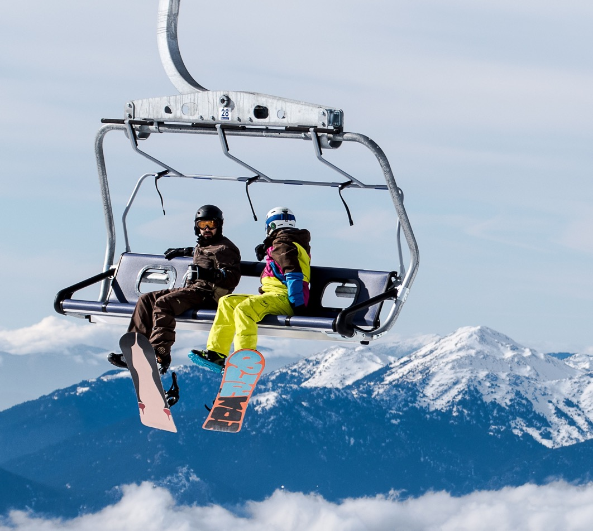
Problem Statement
Big Mountain Resort is not generating enough profit margin respect to the operating costs and condition of the facility
Notes:
© Copyright Showeet.com – Free PowerPoint Templates

Slide 3
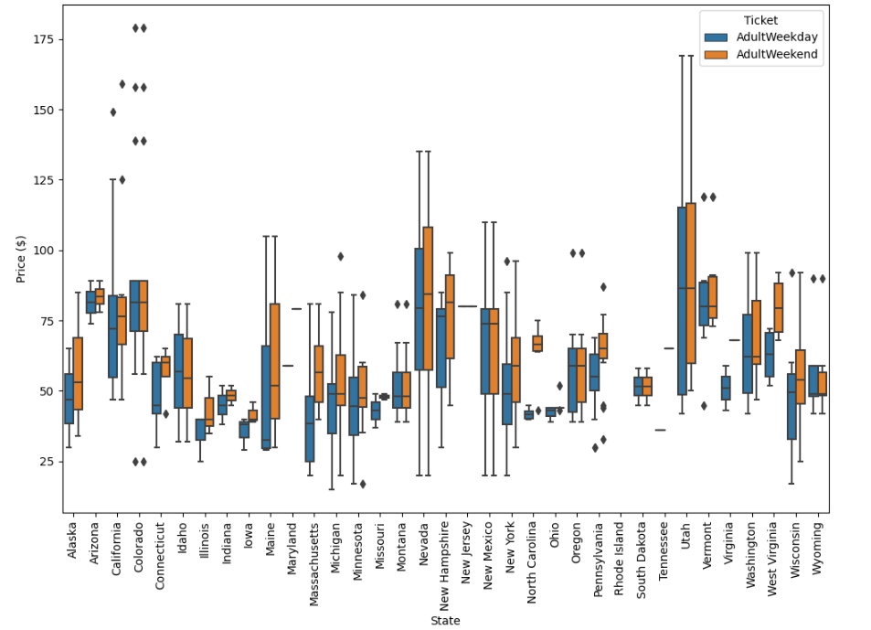
Ticket Prices Market
Prices appear to lie in a broad band from around $25 to over $100.
Price variability change by state.
Montana and Soth Dakota presents small variability in ticket prices.
Nevada and Utah show the most range in prices.

Slide 4
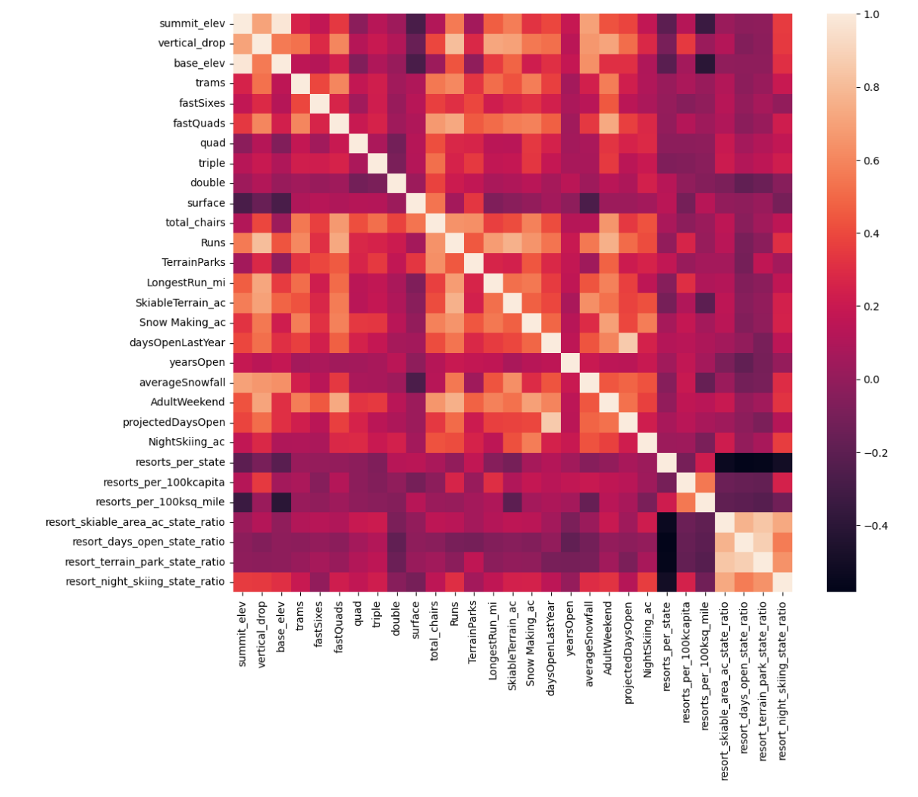
Factors Impacting The Ticket prices
Vertical drop
Snow making
Total chair
Longest run
Runs
Skiable terrain
Notes:
© Copyright Showeet.com – Free PowerPoint Templates

Slide 5
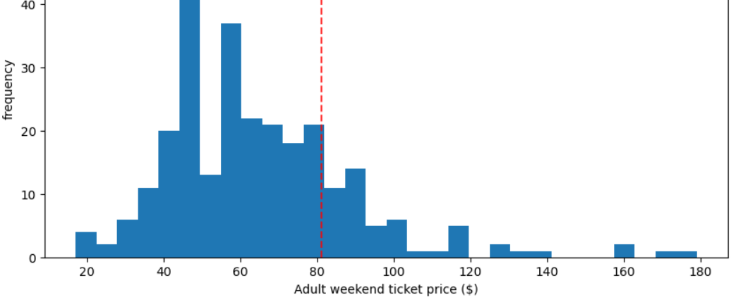
Pricing Model

